Slide 1

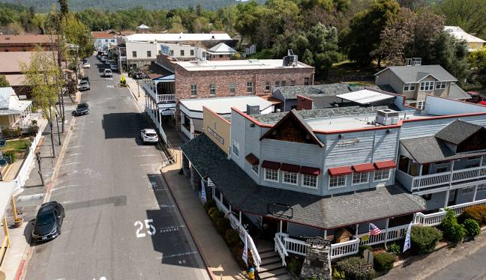

JAMESTOWN SANITARY DISTRICT
Sewer Rate
Proposition 218 Hearing
December 11, 2024
Alison Lechowicz
Project Manager
(510) 545-3182

Slide 2
Current Rates
Last rate study was conducted in 2016
The District paused planned rate increases during the Covid 19 pandemic
Most recent rate increase was July 1, 2022
Fixed monthly bill for all customers
  $81.55 per equivalent single-family residence (ESFR)
  Commercial customers are billed multiple ESFRs proportional to their sewer flow
At the current rate revenues, the District is negative about $500,000 annually. Without a rate increase, the District is projected to become insolvent in four years.

Slide 3
Proposed Financial Plan
Rate increases are needed to
Fund existing operating costs, future inflationary cost increases, and the operations of the new tertiary treatment plant upgrades (when complete)
Pay down existing debt
Maintain reserves
Fund Jamestown Sanitary District capital projects
Fund estimated debt service costs for tertiary treatment upgrades required by TUD
 | Current | 1-Jan-25 | 1-Jul-25 | 1-Jul-26 | 1-Jul-27 | 1-Jul-28
Service Fee | $81.55 | $134.56 | $134.56 | $148.02 | $162.82 | $179.10
Debt Fee* | $0.00 | $0.00 | $0.00 | $0.00 | $0.00 | $49.22
Total Fee | $81.55 | $134.56 | $134.56 | $148.02 | $162.82 | $228.32
*Fee to fund tertiary upgrades

Slide 4
Public Hearing Procedure
Board of Directors will open the hearing and receive public comment
Validate and tally written protest of property owners; protest requirements:
  1) Statement against the rate
  2) Service address of parcel or APN
  3) Printed property owner name
  4) Property owner signature
The rates cannot be adopted if a majority of JSD accounts subject to the rates submit protests (at least 419 accounts)
Absent a majority protest, the first rate adjustment can go into effect January 1, 2025 with Board vote
Each year thereafter, the Board will review its financial status and implement the rates shown in the public notice

